Slide 1

How to retrieve all requests which have a different pickup location than the library of the item
Yoel Kortick
Senior Librarian
Alma Product Management
© Ex Libris Ltd., 2013 - Internal and Confidential

Slide 2
Agenda
Introduction
Creating the report
Using CASE WHEN
The final report

Slide 3
Introduction
This presentation will show two subjects:
How to retrieve all requests which have a different pickup location than the library of the item
  In essence this retrieves items which require transit
How to use the CASE WHEN parameter when designing in a report.
This report works on the “Requests” subject area which is available from the April 2014 release

Slide 4
Introduction
We will use the CASE WHEN parameter to assign a numeric value of
  1 when the item library is equal to the request pickup library
  0 when the item library is not equal to the request pickup library
Then we will filter by “0” to get the cases where item library is not equal to the request pickup library

Slide 5
Agenda
Introduction
Creating the report
Using CASE WHEN
The final report

Slide 6
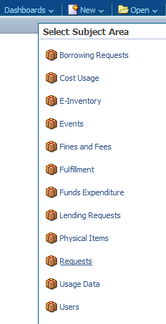
Creating the report
In analytics we will choose ‘New > Analysis > Select Subject Area > Requests’

Slide 7
Creating the report
From the Criteria tab select the fields you wish to appear in the report
In addition to the fields you wish to appear also choose any other field. This “extra” field will later be used for ‘edit formula’ to perform our ‘CASE WHEN’ formula.

Slide 8
Creating the report
We will choose these fields
  Bibliographic Details : Title
  Bibliographic Details : Author
  Library Unit : Library Name
  Request Details : Pickup Location
  Request Details : Pickup Location
    (once to display and once to do CASE WHEN)
  Requester : First Name
  Requester : Last Name

Slide 9
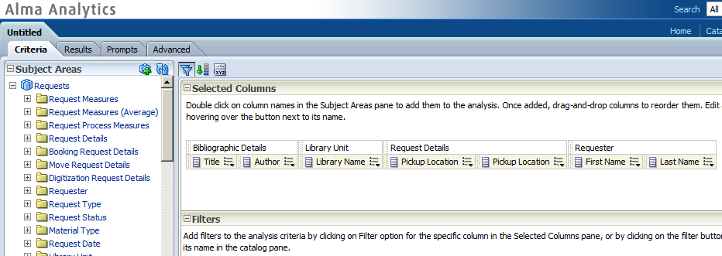
Creating the report
Here is criteria tab of the report at this stage

Slide 10
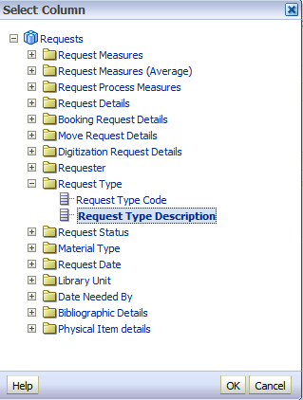

Creating the report
If desired filter by request type

Slide 11
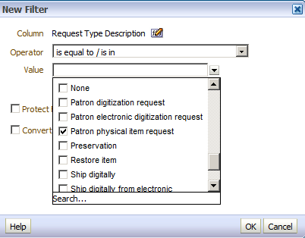
Creating the report
Here we are filtering by ‘Patron Physical Item Request’

Slide 12
Agenda
Introduction
Creating the report
Using CASE WHEN
The final report

Slide 13
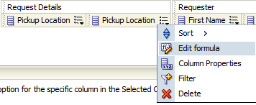
Using CASE WHEN
In one of the ‘Pickup Location’ fields choose ‘Edit Formula’

Slide 14
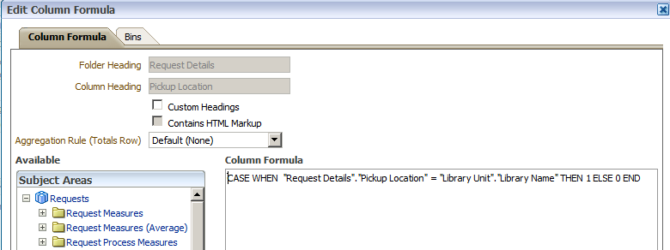
Using CASE WHEN
  In the window that opens enter:
  CASE WHEN "Request Details"."Pickup Location" = "Library Unit"."Library Name" THEN 1 ELSE 0 END

Slide 15
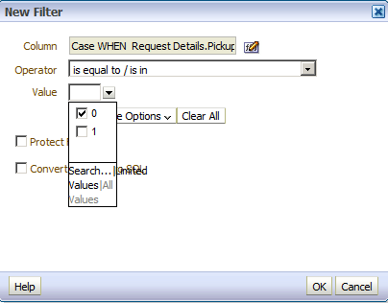
Using CASE WHEN
  Now on this field we will filter for 0 so we get all cases of pickup location not equaling library name

Slide 16
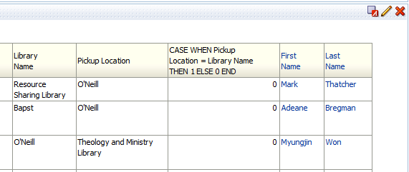
Using CASE WHEN
  In the results tab remove the ‘CASE WHEN’ field from display by editing and moving to “excluded”
Education
Law
Tom
Smith
Education
Medicine
Tony
Jones
Main
Medicine
Angel
Cohen

Slide 17
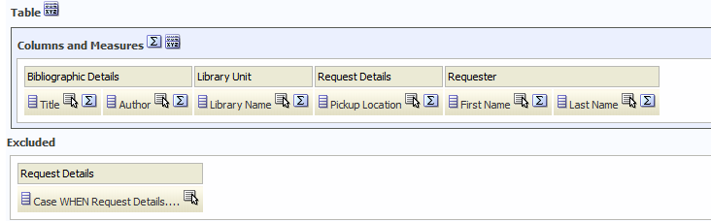
Using CASE WHEN
  In the results tab remove the ‘CASE WHEN’ field from display by editing and moving to “excluded”

Slide 18
Agenda
Introduction
Creating the report
Using CASE WHEN
The final report

Slide 19
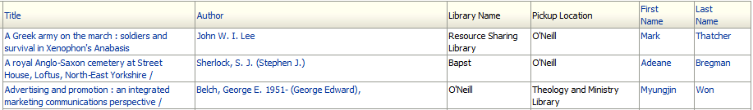
The final report
Education
Law
Tom
Smith
Education
Medicine
Tony
Jones
Main
Medicine
Angel
Cohen
In all cases the Library of the item differs from the pickup location of the request. This it requires transit

Slide 20
Thank You

